Slide 1
Principles of Management and Applied Economics
www.hndit.com
3. Evolution of Management Thought –Part I

Slide 2
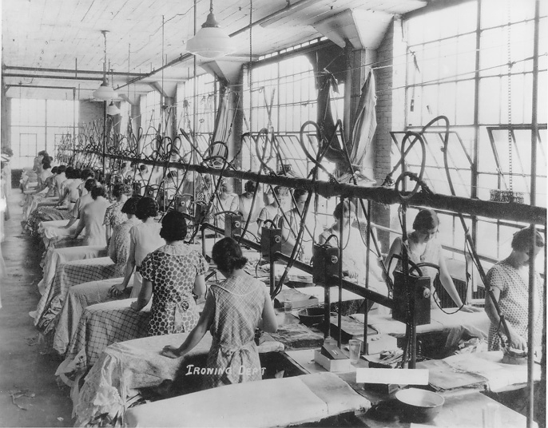
Evolution of Management Thought
www.hndit.com

Slide 3
Progressive Stages of the Evolution of Management
www.hndit.com
Development of informal body of management thought
Main forces that preceded the development of formal body of management thought
Formal body of management thought

Slide 4
Development of Informal Body of Management Thought
www.hndit.com
The Great Pyramids in Egypt in 2700BC - 1700 BC
The Roman Empire
(founding in 27 BC by the Roman Emperor Augustus until the fall in the West in 467 AD and the transition in the East in 610AD)
The Great Wall of China build between 220BC to 206BC
The wondrous work of Sri Lankan Kings

Slide 5
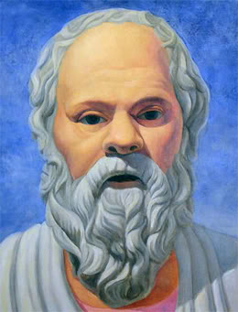
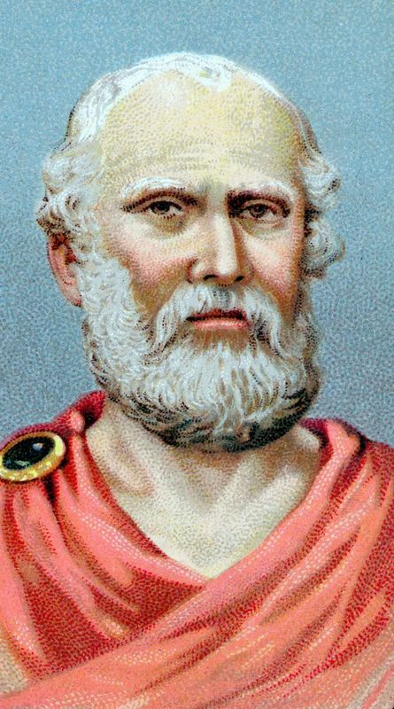
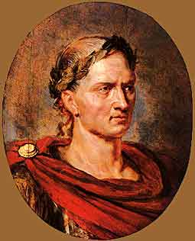
Ancient Contributors to the Management Discipline and examples
www.hndit.com
Socrates
Plato
Julius Caesar
Great Pyramids in Egypt
Great Wall of China
Sigiriya in Sri Lanka

Slide 6
Forces that Preceded the Development of Formal Management Thought in the West
www.hndit.com
The Protestant Work Ethic
Martin Luther and John Calvin (16th Century)
Capitalism and Division of Labour
Adam Smith (Early 17th Century)
The Industrial Revolution
James Watt and Guttanberg (Late 17th Century)
The Productivity Problem
Gradual reduction in organisational efficiency and effectiveness over the years

Slide 7
Evolution of Management Thought
www.hndit.com
1800 1900 1910 1920 1930 1940 1950 1960 1970 1980 1990 2000 2010 Now
Scientific Management Theory, Administrative Management Theory and Bureaucratic Management Theory
The Behavioral School
Management Science Approach
Systems Approach
Contingency Approach
Other Modern Approaches

Slide 8
Development of Formal Body of Management Thought
www.hndit.com
Classical approach
Behavioural approach
Management Science approach
System approach
Contingency approach
Japanese approach
Excellent approach

Slide 9
Classical Approach to Management
www.hndit.com
Scientific Management Theory
Administrative Management Theory
Bureaucratic Management Theory
1800 1900 1910 1920 1930 1940 1950 1960 1970 1980 1990 2000 2010
Scientific Management Theory, Administrative Management Theory and Bureaucratic Management Theory

Slide 10
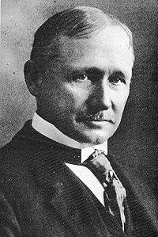
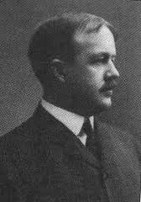
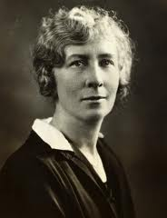
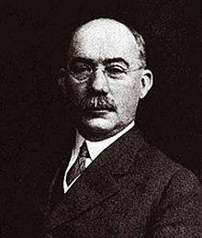
Classical Approach
www.hndit.com
Scientific Management Theory This theory focuses on the improvement of operational efficiencies through the systematic and scientific study of work methods, tools, and performance standards.
Key Contributors to the Scientific Management
F. W. Taylor
(1856-1915)
Frank Gilbreth
(1868-1924)
Lillian Gilbreth
(1878-1972)
Henry Gantt
(1861-1919)

Slide 11
Scientific Management Theory
www.hndit.com
F.W .Taylor - US Engineer/ Father of Scientific Management
Management is considered as a science
of working towards higher productivity
through higher work efficiency.
It believed that there is always a best
standardized method of work for which
the workers can be trained scientifically.

Slide 12
Identified Reasons for Labour Inefficiency and Low Productivity in Organizations Existed in late 19th and Early 20th Century
www.hndit.com
Soldiering
Rule of Thumb
Lack of concern for working conditions
Non-availability of effective incentive methods

Slide 13
Scientific Management Theory
www.hndit.com
The Assumptions of Scientific Management
Economic rational man
One best method of work
Workers have the potential of doing any work prescribed by the science

Slide 14
Scientific Management Theory
www.hndit.com
Principles of Scientific Management
Develop a standard method for performing each job.
The scientific selection of workers.
The scientific education and development (training) of the worker.
Intimate, friendly cooperation between management and labour.
Tie the work performance of employees with the economic rewards.

Slide 15
Scientific Management Theory- The Phases of Scientific Management
www.hndit.com
Phase 1: The work situation
A task to be performed, a pool of workers, and management.
Management
Total task
Pool of workers
(Griffin, 2007)

Slide 16
Scientific Management Theory- The Phases of Scientific Management
www.hndit.com
Phase 2: Task analysis
Management scientifically studies, specializes, and standardizes task elements.
Key:
M= Management
W= Worker
T= Task Elements
M
T 1
T 2
T 3
T 4
T 5
W1
W2
W3
W4
W5
(Griffin, 2007)

Slide 17
Scientific Management Theory- The Phases of Scientific Management
www.hndit.com
Phase 3: Matching tasks with workers
Management selects, trains and assigns workers to task elements.
M
Key:
M= Management
W= Worker
T= Task Elements
W1
W2
W3
W4
W5
T 1
T 2
T 2
T 3
T 4
(Griffin, 2007)

Slide 18
Scientific Management Theory- The Phases of Scientific Management
www.hndit.com
Phase 4: Continued management
Management supervises and maintains planning responsibilities.
M
Key:
M= Management
W= Worker
T= Task Elements
W1
W2
W3
W4
W5
T 1
T 2
T 2
T 3
T 4
(Griffin, 2007)

Slide 19
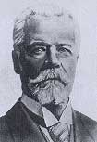
Classical Approach- Administrative Management
www.hndit.com
Administrative Management theory focuses on the improvement of productivity of the entire organization.
Key Contributor to the Administrative Management Theory
Henri Fayol
(1841-1925)

Slide 20
Fayol’s Three Aspects of Management
www.hndit.com
Administrative Theory
The Activities of an Organization
The Functions of Management
The Principles of Management

Slide 21
The Activities of an Organization
www.hndit.com
Technical activities (Production, Manufacturing)
Commercial activities (Buying and selling)
Financial activities (Search for and best use of capital)
Security activities (Safeguarding property and people)
Accounting activities (Recording financial information)
Managerial activities (Planning, organizing, commanding ,coordinating and controlling)

Slide 22
The Functions of Management
www.hndit.com
Plan
Organize
Command
Co-ordinate
Control

Slide 23
Fayol’s 14 Principles of Management
www.hndit.com
1. Division of Labour | 8. Authority
2. Discipline | 9. Unity of Command
3. Unity of Direction | 10. Subordination of Individual Interest to the Common Goal
4. Remuneration | 11. Centralization
5. The Hierarchy | 12. Order
6. Equity | 13. Stability of Staff
7. Initiative | 14. Esprit de Corps

Slide 24
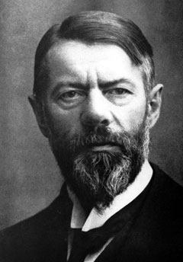
Classical Approach Bureaucratic Management Theory This theory stressed the need for a strictly defined hierarchy governed by clearly defined rules and regulations and line of authority in an organization.
www.hndit.com
Key Contributor to the Bureaucratic Management Theory
Max Weber
(1864-1920)

Slide 25
Bureaucratic Management Theory
www.hndit.com
Characteristics of a Bureaucratic Organization
Clearly defined objectives
A set of impersonal and logical rules and routine
Division of labour
Positions arranged in a hierarchy
Clearly defined authority
Selection based on technical qualifications
Strict adherence to a clear chain of command

Slide 26
Comparison of Theories in Classical Approach
www.hndit.com
 | Taylor | Fayol | Weber
Focus | Individual work efficiency (Micro) | Organizational efficiency (Macro) | Bureaucratic rationality (Macro)
Orientation | Industrial engineering | Managerial | Sociological
Methodology | Scientific Methods | Administrative Principles | Bureaucratic principles

Slide 27
General Criticisms on Classical Approach
www.hndit.com
Too much emphasis on principles, structures and methods (Technical Factors) in order to improve productivity.
Social and psychological needs of the workers were not recognised adequately .
Worker was considered as a slave or a machine.
Too much emphasis on capital as the main input factor.
Not recognised the informal behaviour of humans.

